Slide 1
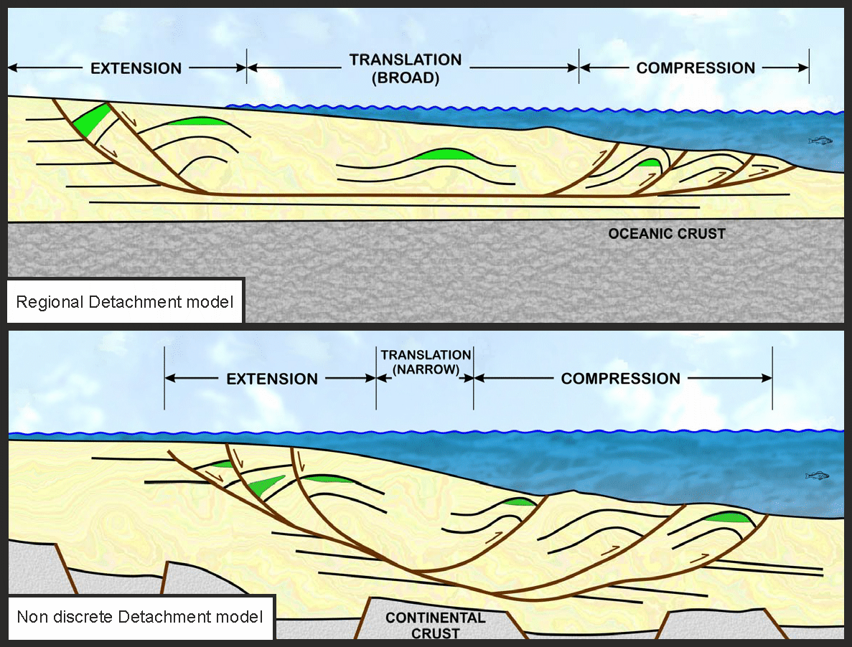
Figure 1

Slide 2
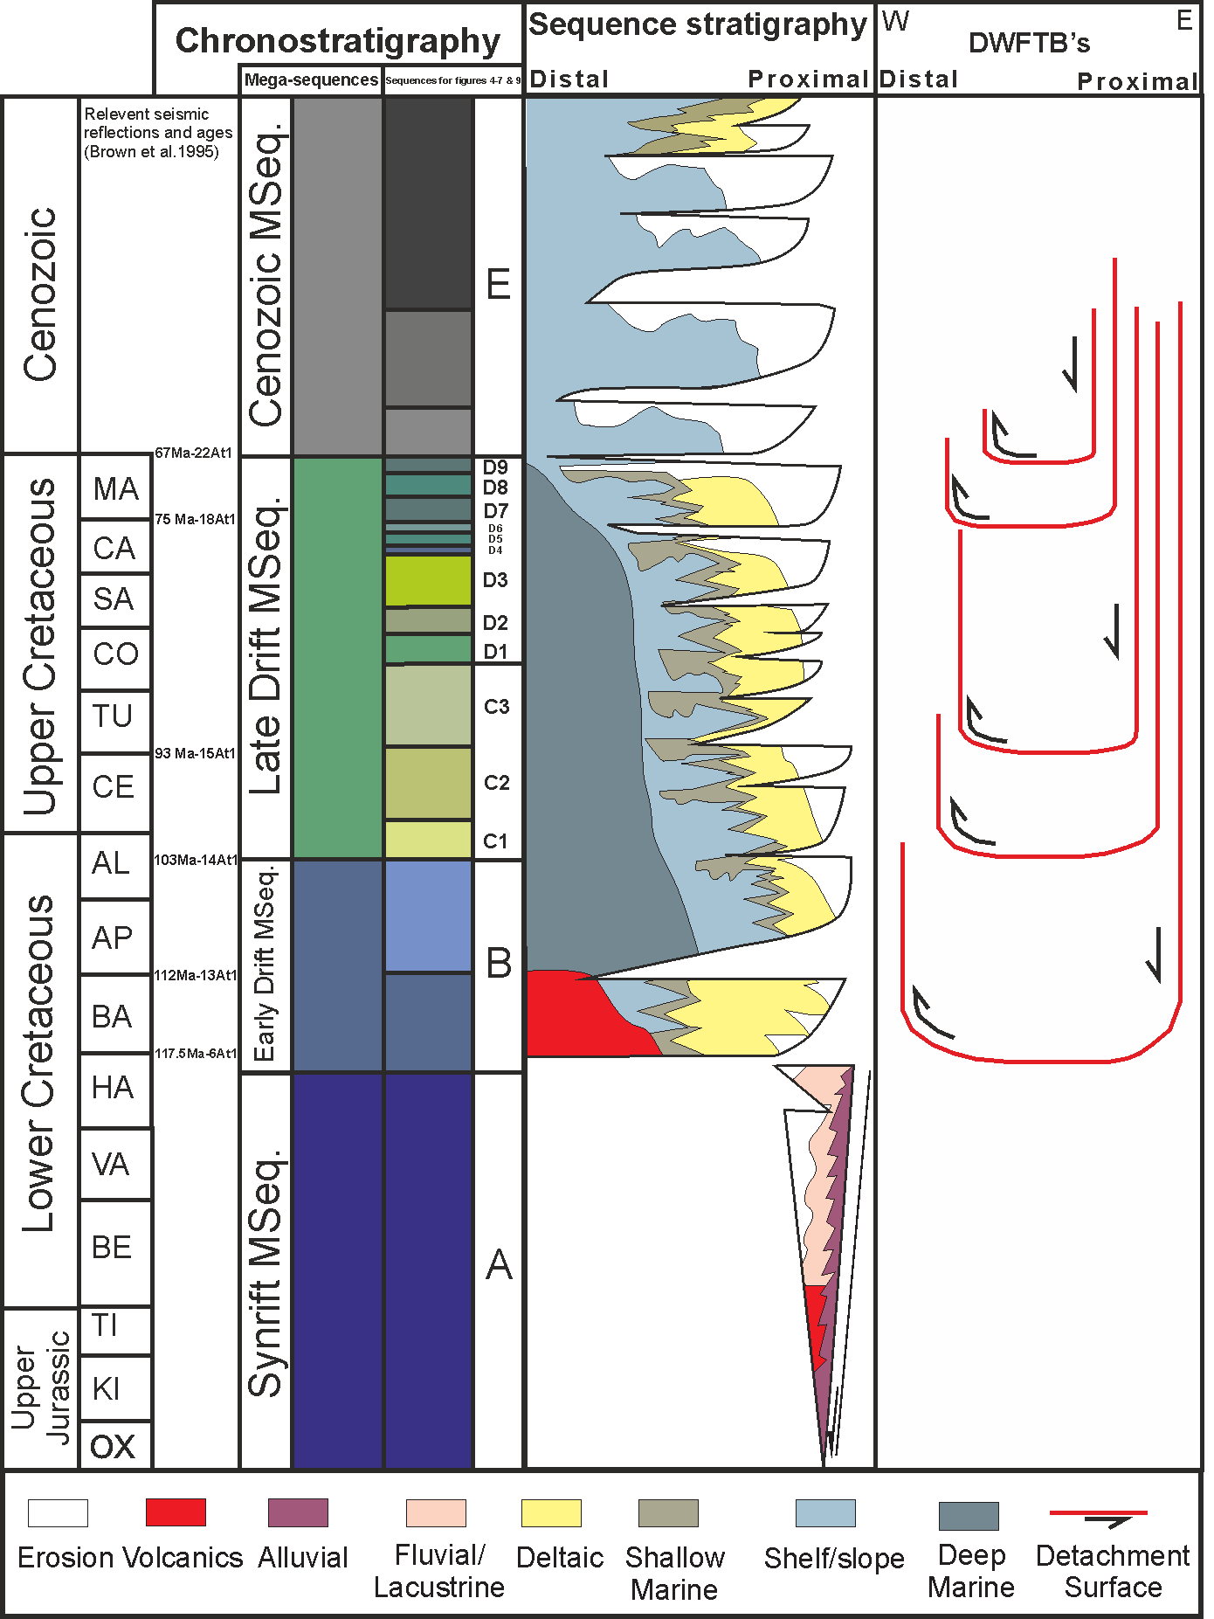
Figure 2

Slide 3
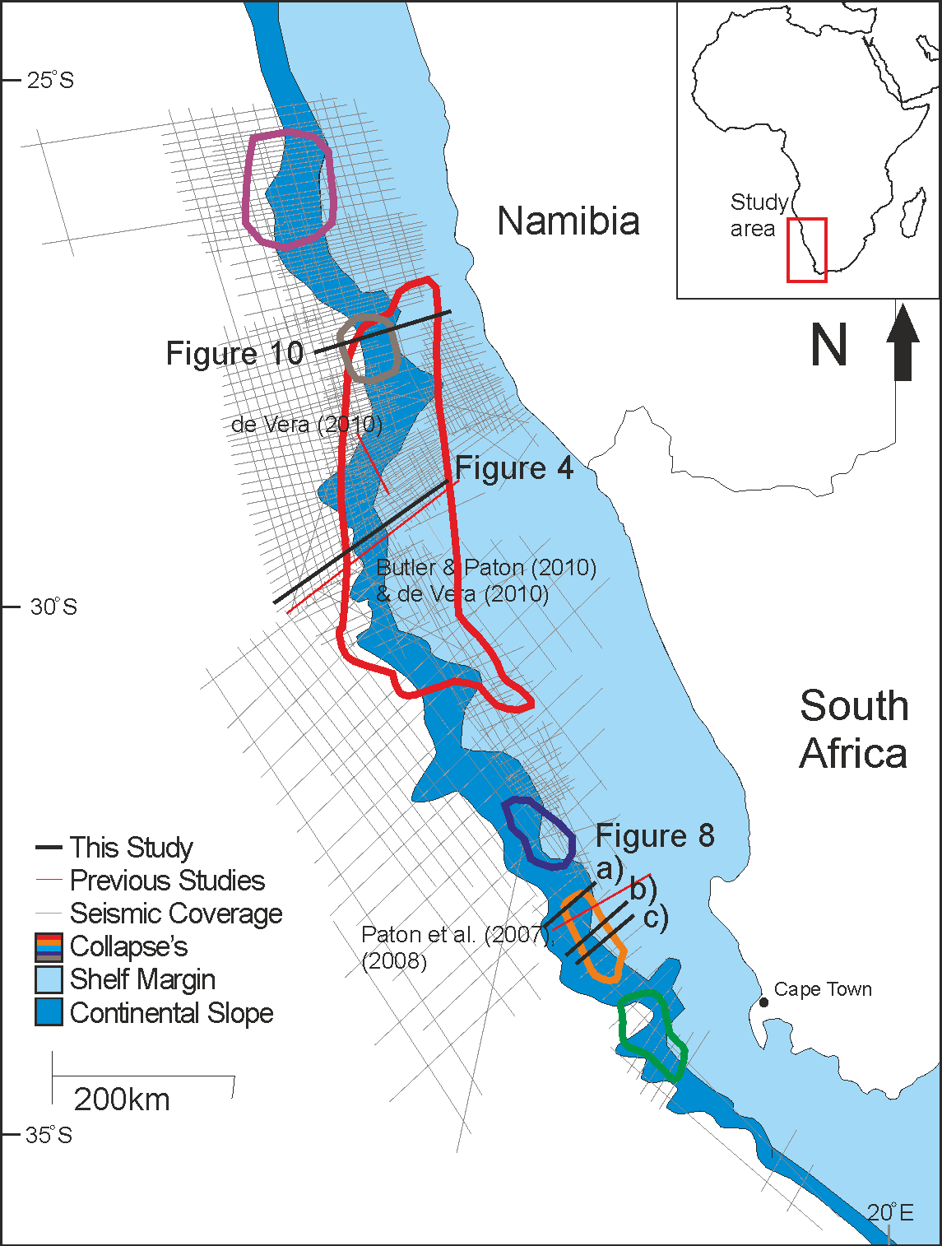
Figure 3

Slide 4
Figure 4

Slide 5
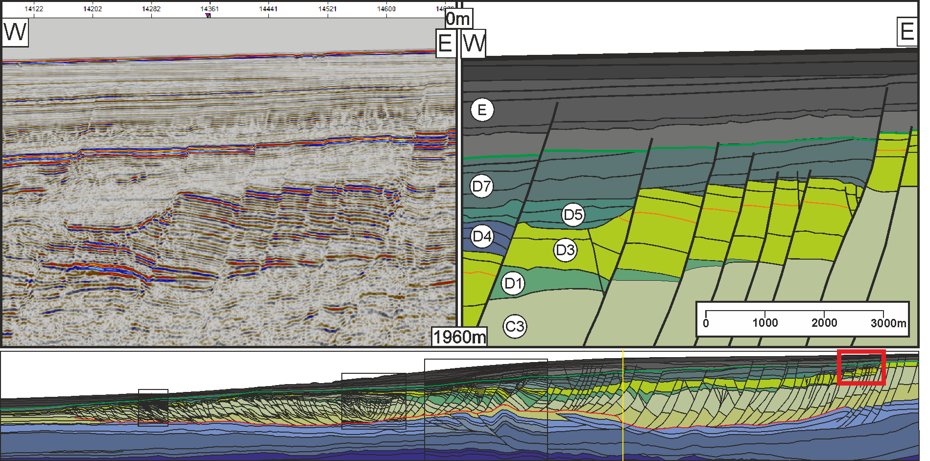
Figure 5

Slide 6
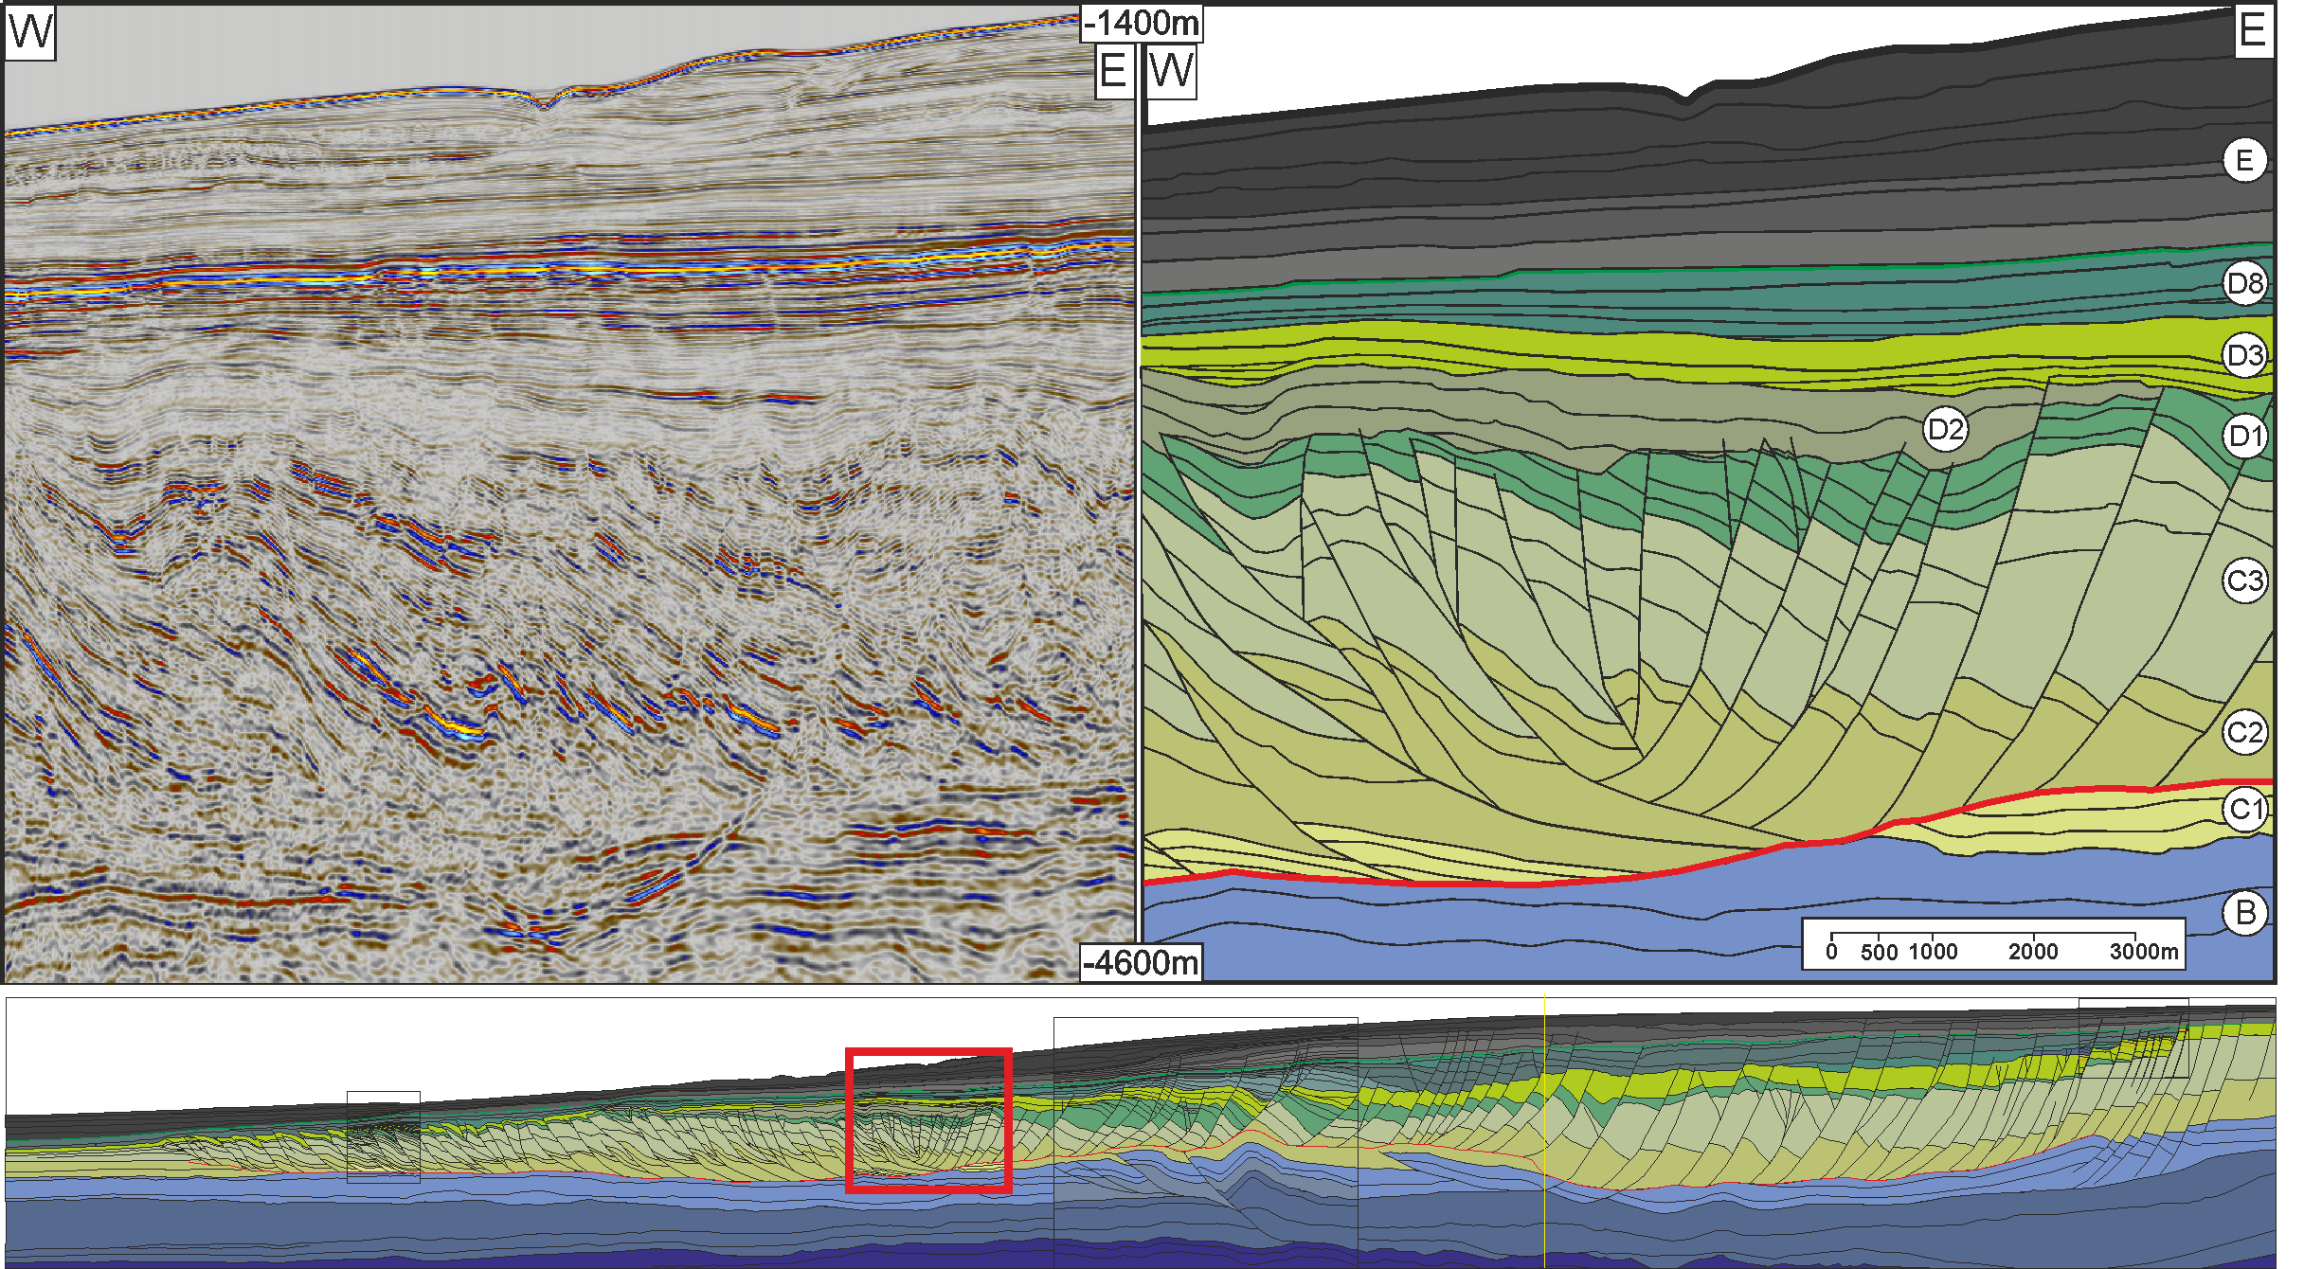
Figure 6

Slide 7
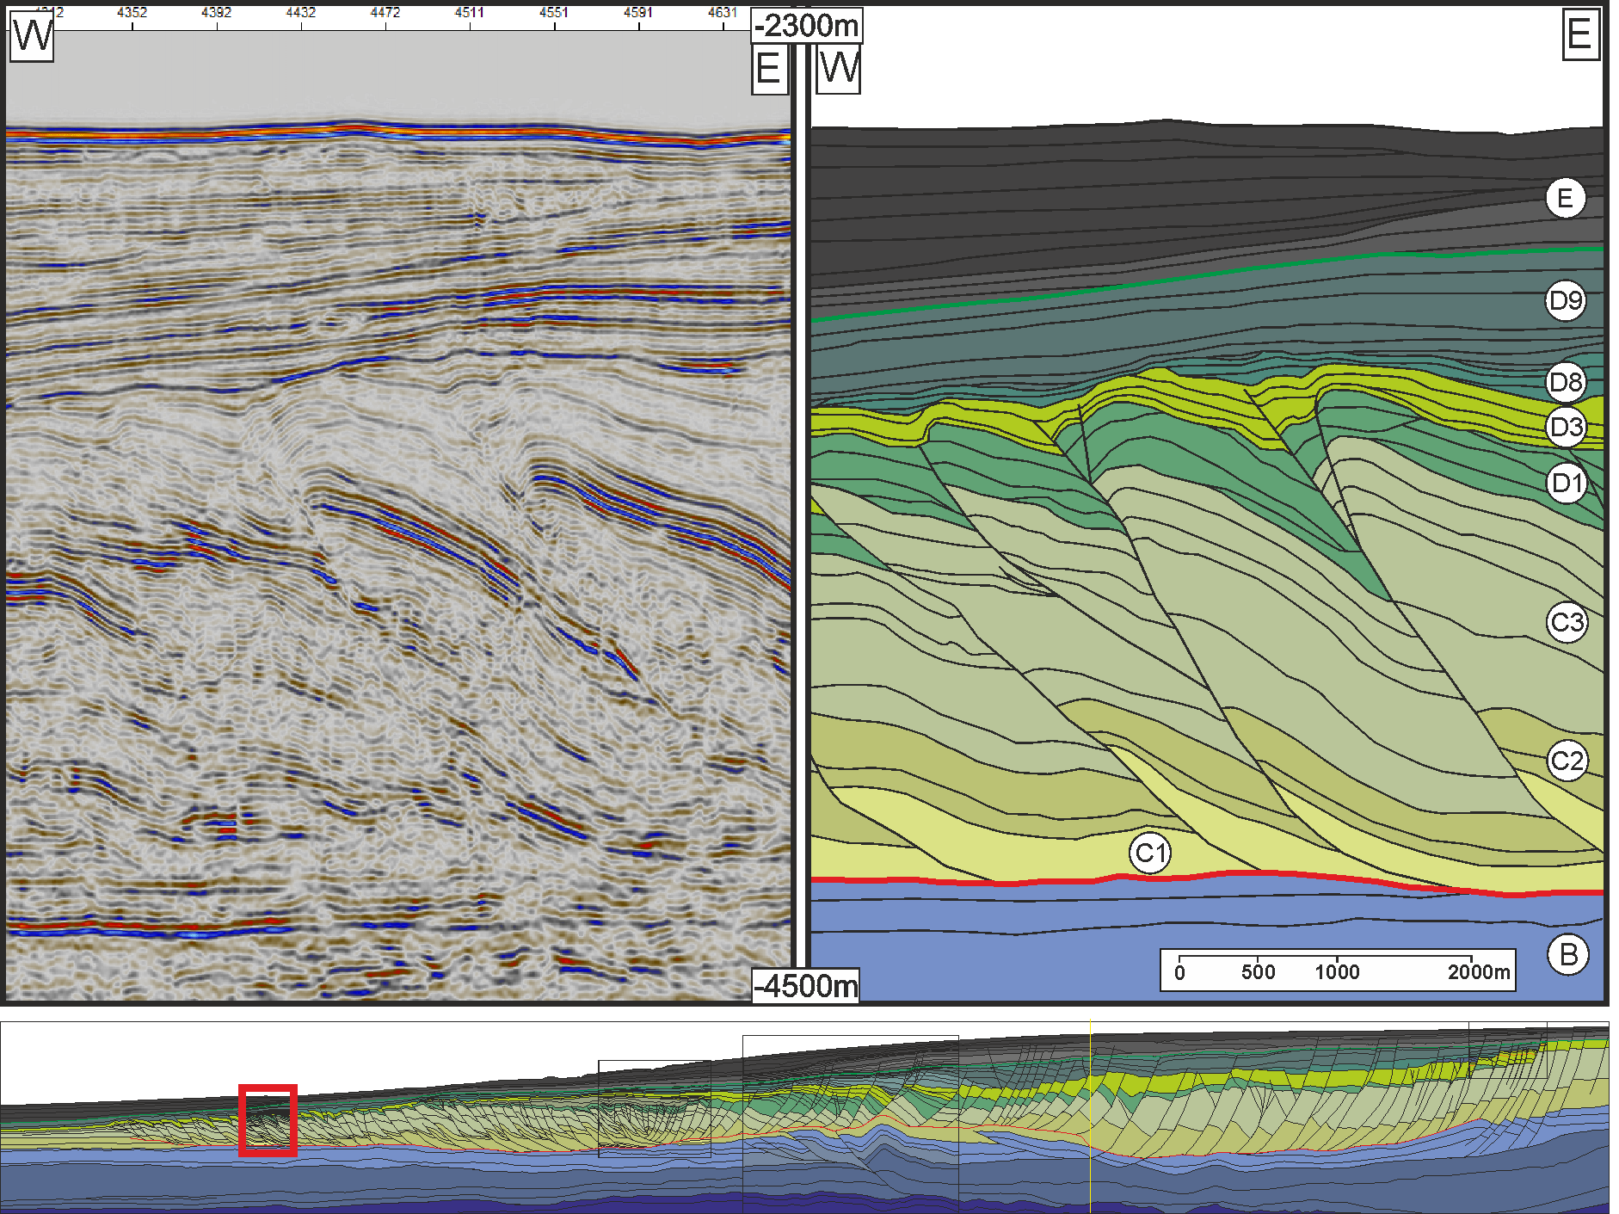
Figure 7

Slide 8
Figure 8

Slide 9
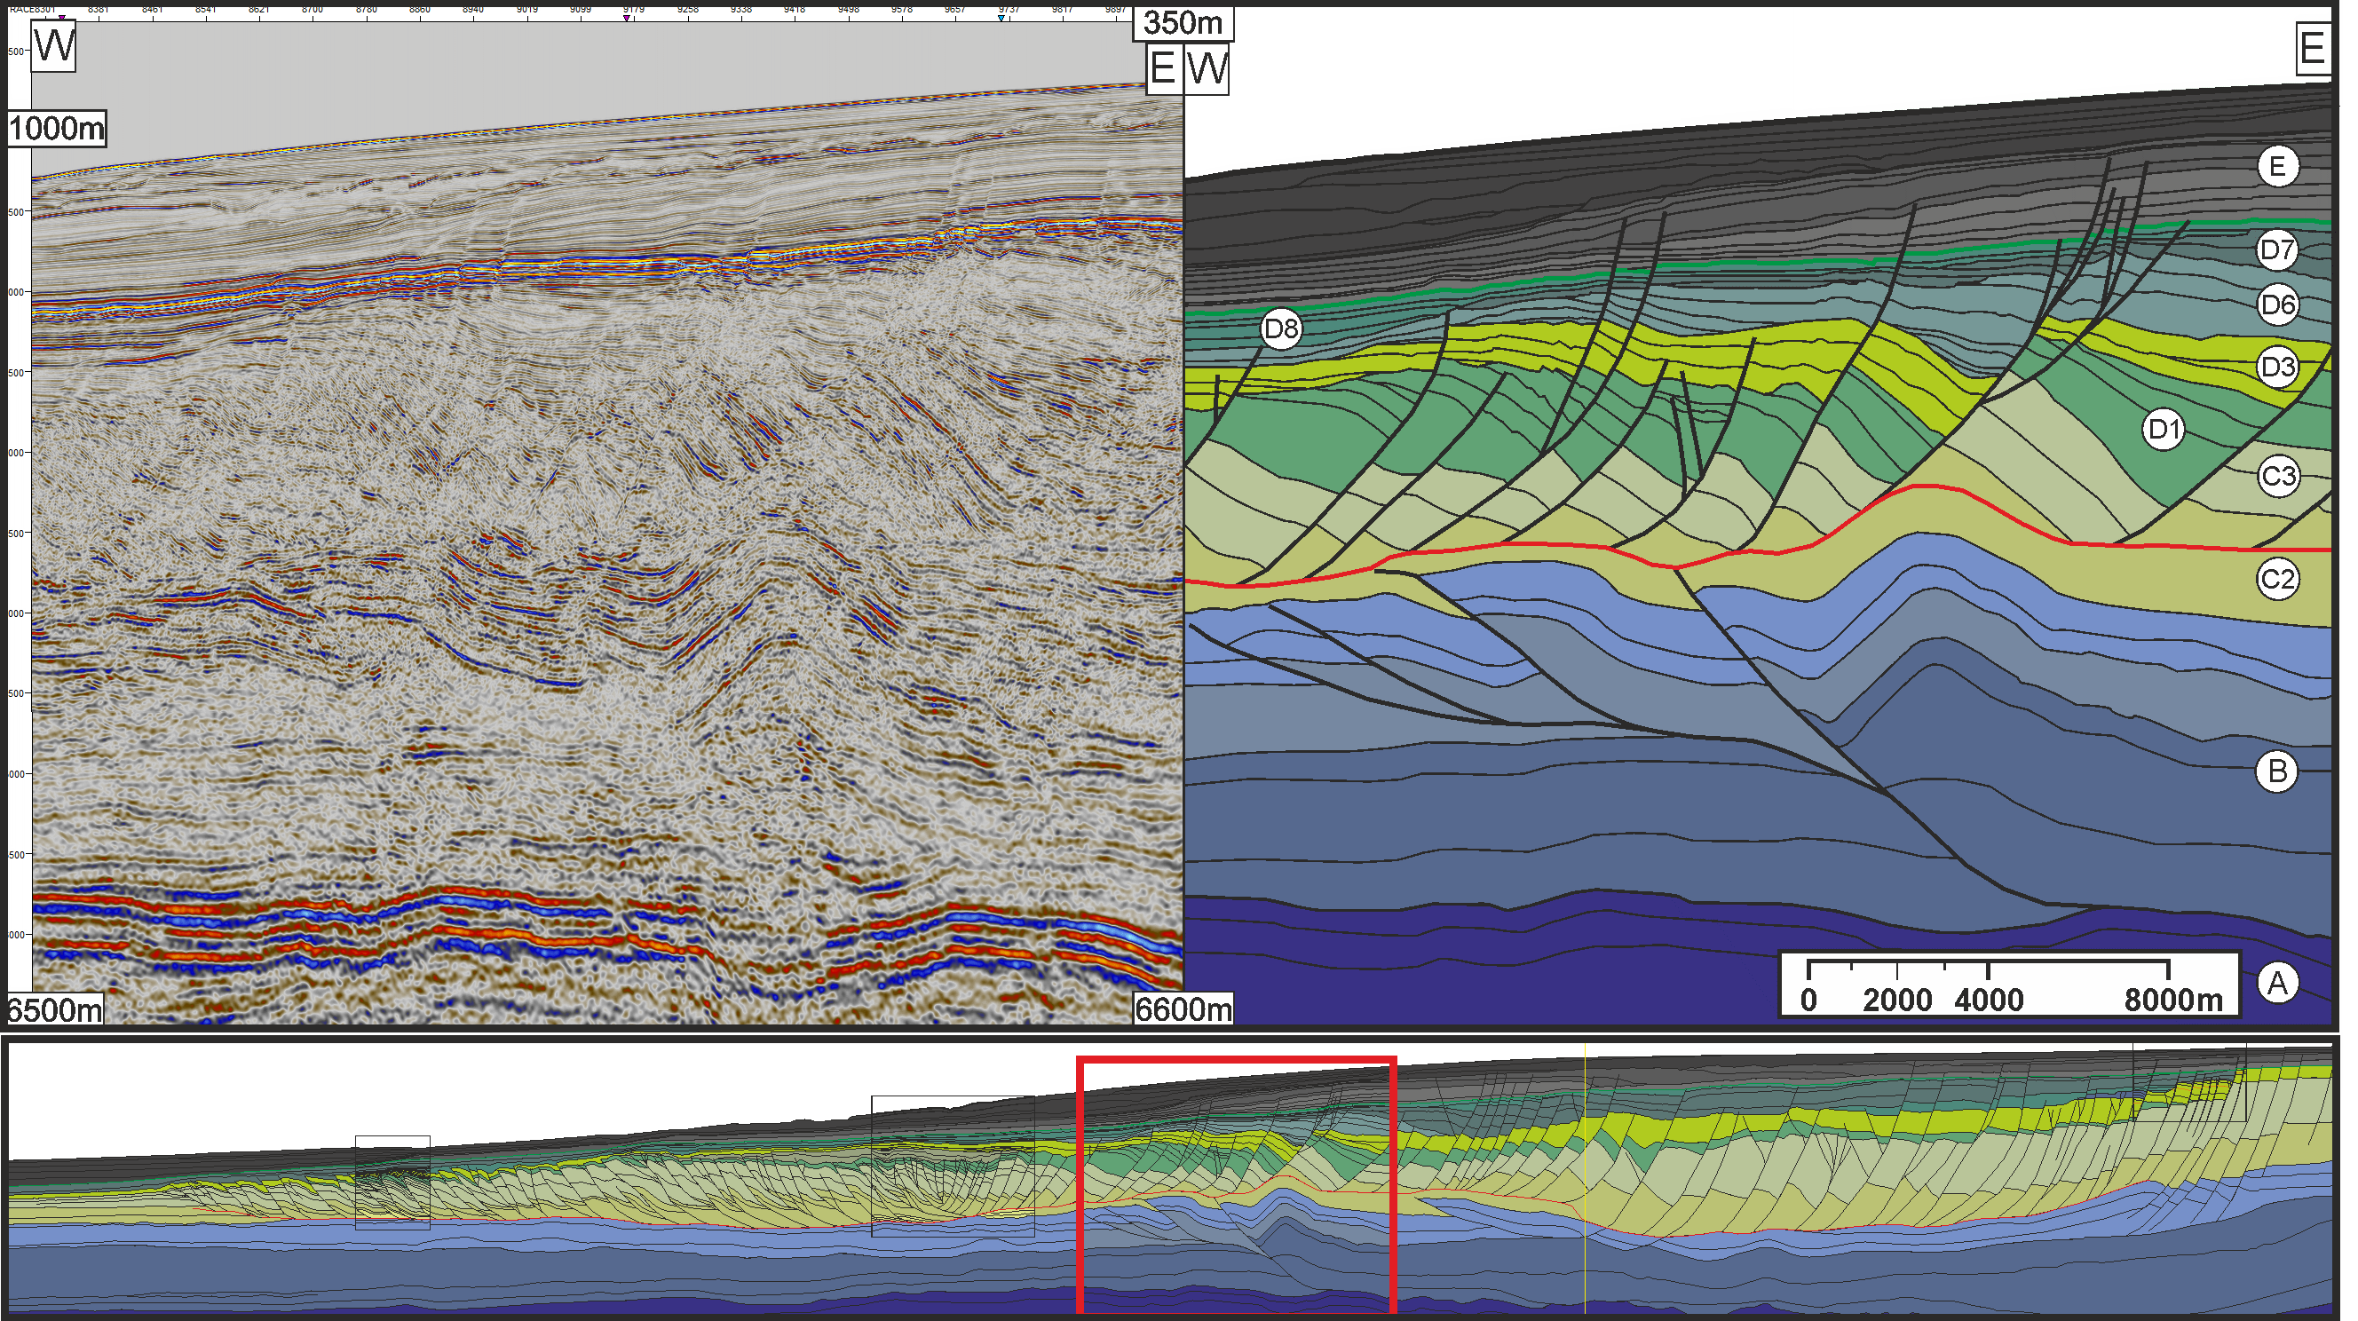
Figure 9

Slide 10
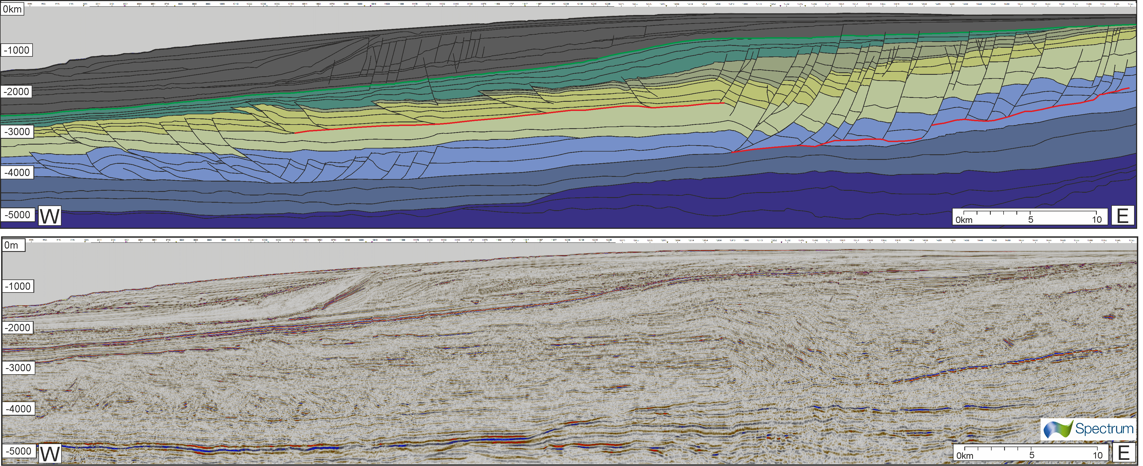
Figure 10

Slide 11
Figure 11

Slide 12
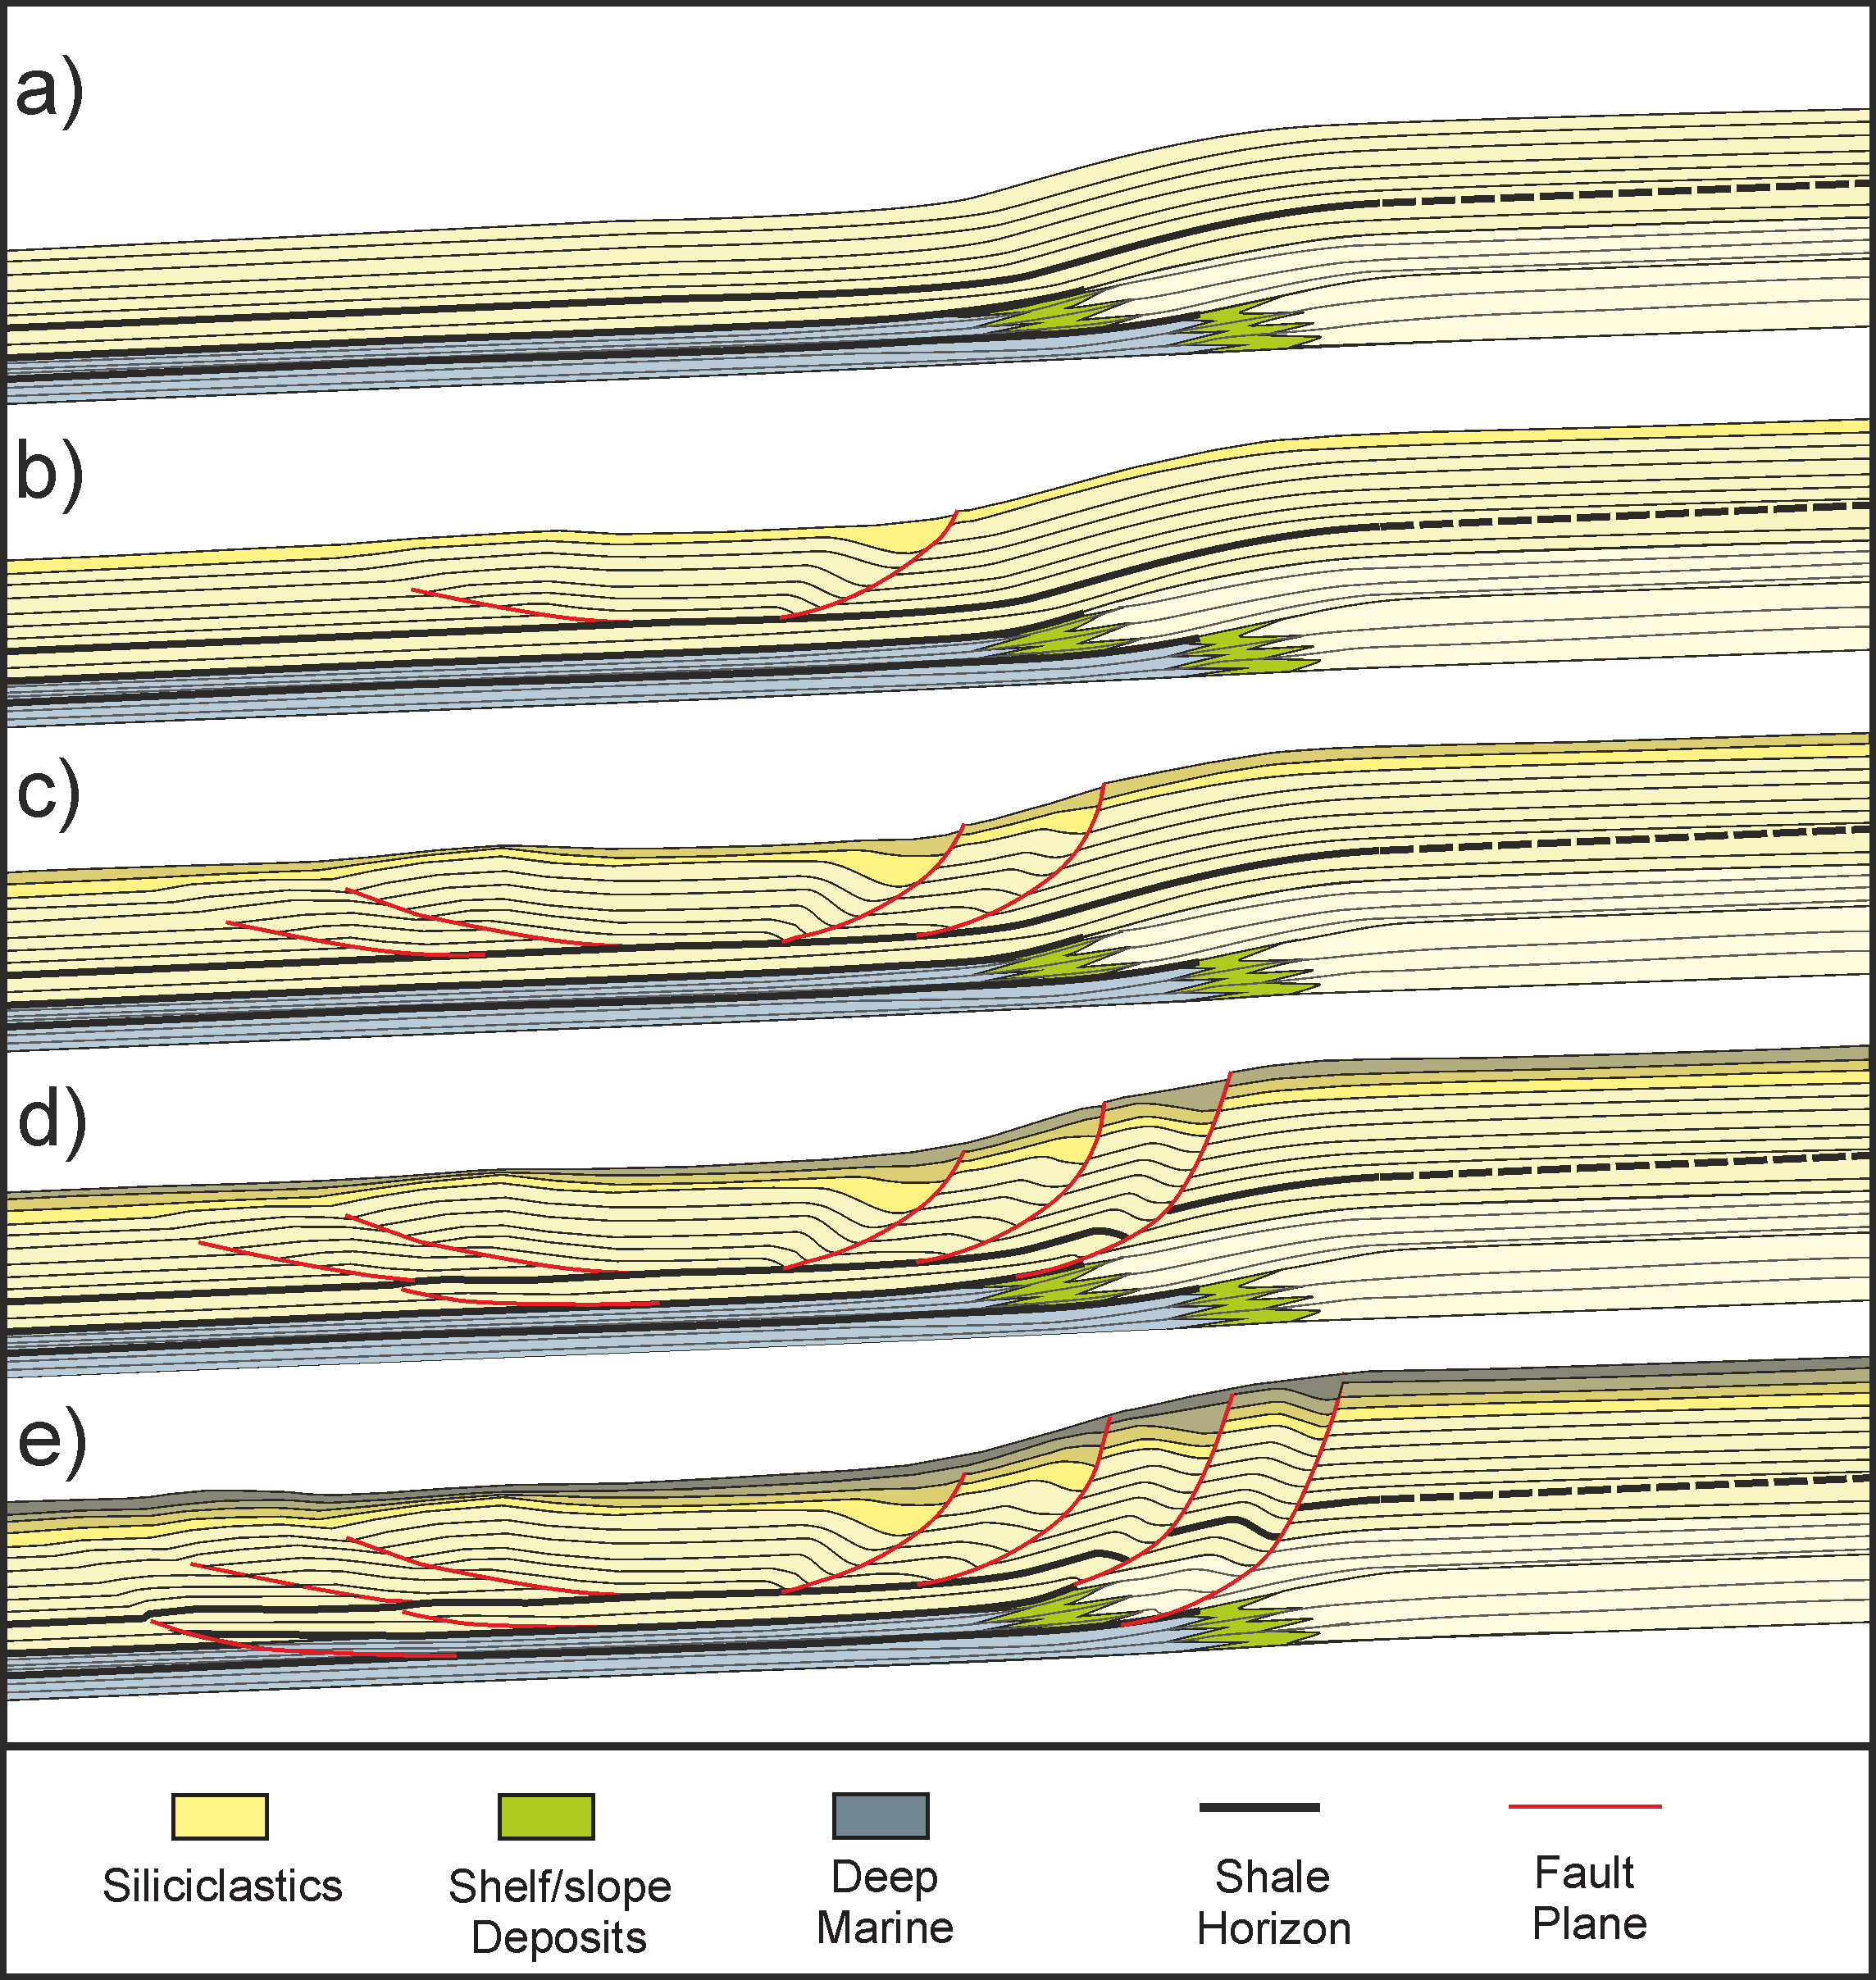
Figure 12

