Slide 1

North Yorkshire County Council
Scarborough, 9 March 2015
‘Coastal not coasting’
Educational attainment in coastal towns
What is going on elsewhere?
peter.rudd@york.ac.uk Peter Rudd

Slide 2


The starting point
Ofsted (2013):
Unseen children: access and achievement 20 years on

Slide 3
The starting point
The distribution of underachievement has shifted. Twenty or thirty years ago, the problems were in the big cities. Inner London schools were the best funded and worst achieving in the country. Now, schools in inner and outer London are the best performing, and performance in parts of Birmingham, Greater Manchester, Liverpool and Leicester has also improved.

Slide 4
The starting point
The areas where the most disadvantaged children are being let down by the education system in 2013 are no longer deprived inner city areas, instead the focus has shifted to deprived coastal towns and rural, less populous regions of the country, particularly down the East and South-East of England.
(Ofsted, 2013, Press Release)

Slide 5
Map shows the 97 secondary schools (purple dots) serving above average proportions of FSM pupils, with the highest performance at GCSE for these pupils (Source: Ofsted, 2013, p.50)

Slide 6
Map shows the 111 secondary schools (green dots) serving above average proportions of FSM pupils, with the lowest performance at GCSE for these pupils (Source: Ofsted, 2013, p.51)

Slide 7
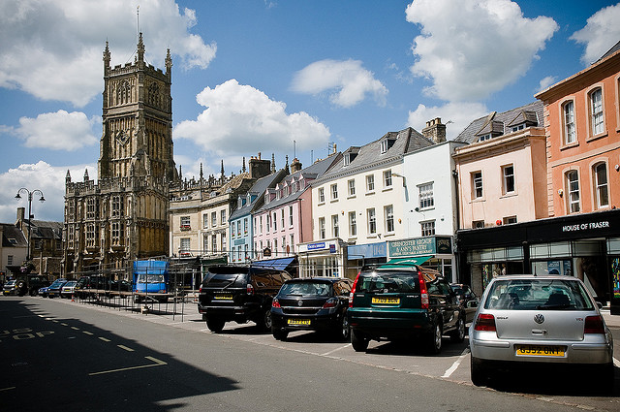
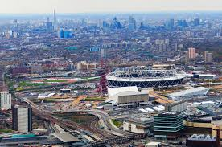
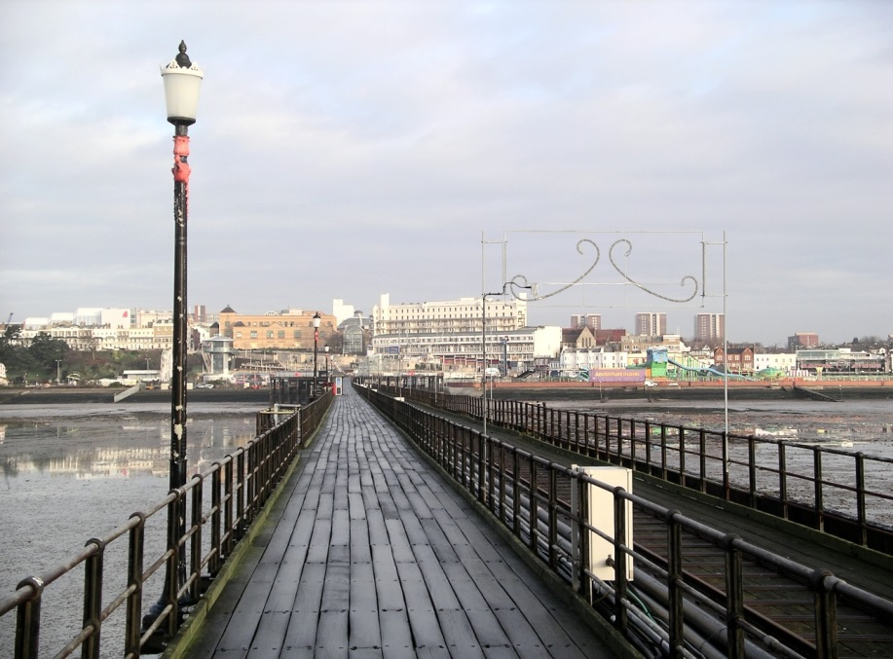
Changing patterns of underachievement

Slide 8
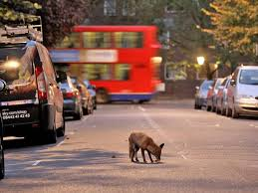
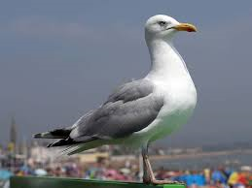
Changing patterns of underachievement

Slide 9
Response to the Ofsted report
Julie Nelson and Richard White (NFER) argue that: Sir Michael’s recommendations relate almost exclusively to the school and FE sectors – but of course, it is well known that disadvantaged children often have complex barriers to learning, which mean that they need the support of a wide range of other professionals. (NFER blog, 20 June 2013)

Slide 10
What’s going elsewhere?
‘The Battle of Hastings’
Education Improvement Partnerships (x7)
Sharing of good practice and school support
Project 1: improving literacy / reading
Project 2: involving parents and carers more in their children’s education

Slide 11
What’s going elsewhere?
‘Improving Learning Together’ Southend-on-Sea
Cycle of review/evaluation/support/challenge
Preferred model of school-to-school support
Evidence-based: termly evaluation of schools
Zero tolerance for assumptions linking social disadvantage with underachievement

Slide 12
What’s going elsewhere?
‘Raising the Bar’: Felixstowe / Suffolk
County-level ‘Raising the Bar’: raising attainment & aspiration across the age range
Joined up: The Learning Partnership - sharing best practice across the county
Felixstowe: two secondary schools merged into one academy
Regeneration: ‘Felixstowe’s New economy’

Slide 13
What do coastal towns have in common?
For discussion:
‘Isolation’: weak transport links?
High number of white working class residents?
On the fringe of / or excluded from national educational initiatives (inc Pupil Premium?)
Poor / seasonal employment?
Low literacy levels / weak parenting?
Poor quality / multi-occupancy housing?

Slide 14
Recommendation 1
Construct checklists of school improvement strategies from the Ofsted report and apply them (and monitor them regularly) to the NYCC Coastal Project by individual school

Slide 15
Recommendation 2
There are now many sources of shared good practice and evidence-based ‘what works’ resources and websites. Systematically check these for programmes and interventions that might be useful for the NYCC Coastal Project.

Slide 16
Recommendation 3
Use specified criteria for attainment and under attainment to ‘scientifically’ identify relevant ‘coastal towns’. Also use set criteria to identify successful and less successful schools within these coastal towns.

Slide 17
Recommendation 4
Identify and outline the school improvement and effectiveness programmes being implemented in these coastal towns. Pin down the successful elements of these programmes and use ‘knowledge mobilisation’ to share good practice.

Slide 18
Recommendation 5
Take a broad view of where ‘good practice’ might come from. If possible, construct a matrix of successful practice? Consider early years provision, schools, colleges, CYP more broadly, social work, parenting, policing, health and well-being, the local economy, business and community partnerships.

Slide 19
Recommendation 6
Organise a conference or seminar of education and CYP representatives from coastal towns, to share concerns / issues and good practice. Involve practitioners, policy makers, and researchers.
Locally, use a working group to steer the project, and to ensure that agreed aims are met and recommendations implemented.

Slide 20


