Slide 1
A
Chloroplast
B
Chloroplast
O₂
¹O₂
RuBP
O₂
¹O₂
3
RuBP
CO₂
O₂
CO₂
O₂
PSII
Glycolate
PSII
Glycolate
NADPH
PGA
NADPH
PGA
PSI
PSI
NADP⁺
NADP⁺
.
.
O₂
2
O₂
O₂
Sugar-P
O₂
Sugar-P
H₂O₂
H₂O₂
Peroxisome
O₂
Glycolate
Peroxisome
O₂
Glycolate
H₂O₂
1
H₂O₂
Glyoxylate
Glyoxylate
CO₂
CO₂
CO₂
CO₂
CO₂
CO₂
CO₂
CO₂
CO₂
CO₂
CO₂
CO₂
Leaf interior
CO₂
CO₂
CO₂
CO₂
CO₂
CO₂
CO₂
CO₂
CO₂
CO₂
Epidermis
Figure 1. Current concepts of how drought increases the generation of reactive oxygen species (ROS) in photosynthesis. A. Cartoon of leaf section in well-watered plants in which relatively high intercellular CO₂ concentrations (C_{i}) allow efficient regeneration of terminal oxidants and limit RuBP oxygenation. B. Drought-induced stomatal closure restricts CO₂ uptake, favoring photorespiratory production of H₂O₂ in the peroxisome (1) and possibly favoring production of superoxide and H₂O₂ (2) or singlet oxygen (3) by the photosynthetic electron transport chain.

Slide 2
CYTOSOL
Plasma
Membrane
APOPLAST
NADPH
NADPH oxidase
O₂
Superoxide
dismutase
H₂O₂
Flavocytochrome
-
CuZn
NADP⁺
O₂.
Class III peroxidase
O₂
Superoxide
dismutase
H₂O₂
e-
Heme
-
CuZn
O₂.
Amine oxidase
O₂
Polyamine oxidase
O₂
Putrescine
Cadaverine
Cu
H₂O₂
Spermidine
Spermine
FAD
H₂O₂
Oxalate oxidase
O₂
Oxalate
Mn
H₂O₂
Figure 2. Multiple ROS-producing enzymes at the cell surface/exterior. Enzymes are shown in blue and their redox cofactors are indicated in yellow. Class III peroxidases may accept electrons from several types of compound to generate superoxide, but in many cases their physiological reductant is not established (reviewed by O’Brien et al., 2012).

Slide 3
Figure 3. The 15 of the 302 redox-linked genes that respond > 2-fold in the same direction in both drought 1 and drought 2 datasets and their response in related conditions. Data extracted from Genevestigator are shown as log₂ values compared to controls. Red and green indicate induction and repression. Genes are ordered from top according to the number of conditions in which they respond. The full list of genes and their expression values are given in Supplemental Table S1. For details of experiments, see Supplemental Table S2.

Slide 4
Thiol-independent peroxide metabolism
Antioxidative systems participate in signaling
by their effects on peroxide levels
Thiol-dependent peroxide metabolism
Signaling is also possible through antioxidative activity per se
H₂O₂
2 H₂O
H₂O₂
2 H₂O
ROOH
ROH
ROOH
ROH
ROOH
ROH
CAT
APX
GST
PRXII
PRXII
2CPRX
2CPRX
SH
SH
SOH
SH
H₂O₂
O₂
ASC
MDHA
DHA
ASC
GSH
GSSG
SH
SH
SOH
SH
+ GSH
MDHAR
DHAR
PRXII
2CPRX
GSS
SH
S S
NAD(P)⁺
NAD(P)H
GSH
GSSG
GRX
GRX
NTR/TRX
NTR/TRX
SH
GSS
SH
SH
SH
SH
S S
GSH
GSSG
Dismutation by catalase
APX functioning independently of glutathione
Ascorbate-glutathione pathway
GST glutathione peroxidase function
Glutathione-linked peroxiredoxin
Thioredoxin-linked peroxiredoxin
Figure 4. Peroxide-removing enzymes: roles as antioxidants, in signaling, or both? Cartoon of the best characterized peroxide-metabolizing enzymes in plants. Other mechanisms are possible and for ease of display reactions are not shown stoichiometrically. APX, ascorbate peroxidase. CAT, catalase. DHAR, dehydroascorbate reductase. GRX, glutaredoxin. GST, glutathione S-transferase. MDHAR, monodehydroascorbate reductase. NTR, NADPH-thioredoxin C. PRXII, type II peroxiredoxin. 2CPRX, 2-cys PRX. TRX, thioredoxin.

Slide 5
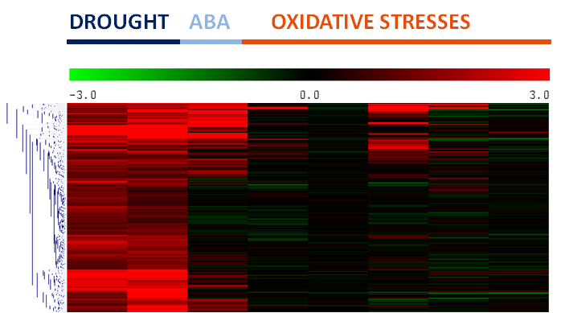
A
B
66
272
37
Total number of drought-induced genes = 375
C
-
ABA
Paraquat: O₂, H₂O₂
(chloroplast)
flu: singlet O₂
(chloroplast)
246
375
317
129
0
58
External H₂O₂
(extracellular)
Paraquat: O₂⁻, H₂O₂
(chloroplast)
flu : singlet O₂
(chloroplast)
DROUGHT 1
cat2: H₂O₂
(peroxisome)
DROUGHT 2
ABA
cat2: High CO₂
External H₂O₂
(extracellular)
cat2: H₂O₂
(peroxisome)
cat2: high CO₂
(negative control)
Oxidative stress marker transcripts
(log₂ treated/control)
360
354
372
15
21
3
Figure 5. Analysis of drought-inducible gene expression in responses to redox perturbation. A. Heatmap of drought-induced genes extracted from Genevestigator and the response of these genes to ABA or oxidative stress (top), and histogram showing expression of oxidative stress marker genes after the different treatments (bottom). Data are shown as log₂ values compared to Col-0 (wild-type or untreated). Experimental details are given in Supplemental Table S2. Red and green on the heatmap indicate induction and repression according to the color scale shown at the top. The five genes for which data are shown in the bottom histogram are (left to right) APX1, GSTU24, UGT75B1, UGT73B5, and GPX6 (for values, see Supplemental Table S3B). B. Overlap of induced genes (cut-off 2-fold) in the two drought experiments. 375 genes were induced >2-fold in at least one of the experiments (Supplemental Table S3A). C. Number of these 375 genes that were induced > 2-fold by the different oxidative stresses (indicated in red circles within the outer blue circles).

