Slide 1
Concerning disadvantaged groups in urbanization—social security for unemployed and low-income, an example of U.K.
Professor Christine Skinner, University of York, UK.
Henan university of economics and law, zhengzhou. china
October 26 2017 ‘Longzi Lake International Forum of Midwestern Economy and Social Development and Industry Innovation’

Slide 2
Introduction
Define Welfare State
UK Social Security System
Working age adults:
Means-tested support - Universal Credit
Conditionality
Sanctions
Support entrepreneurs - self-employment

Slide 3
State Welfare
Majority of ‘welfare’ not delivered by the state in UK, we have a mixed economy of welfare (services provided by private, public, not-for-profit and informal sectors).
Difficult define welfare state – it is extensive and covers education provision, health and social care services, pensions and other things.
A simpler definition is WS = a function of Government and its departments.
One function of the welfare state, is to provide social security benefits to vulnerable citizens’ in need
Narrow definition of Social Security: system of income maintenance – it provides cash benefits for those in need/ in periods of vulnerability
Notes:
State Welfare:
UK – Welfare services gives impression the majority of welfare delivered by the state.
Not so – we have a mixed economy of welfare – with services provided by private, public, not-for-profit and informal sectors.
Difficult to define and analyse ‘the state’ and welfare, they stick to defining the functions of Government:
Central government (Westminster parliament – the PM – the Cabinet – Gov depts).

Slide 4
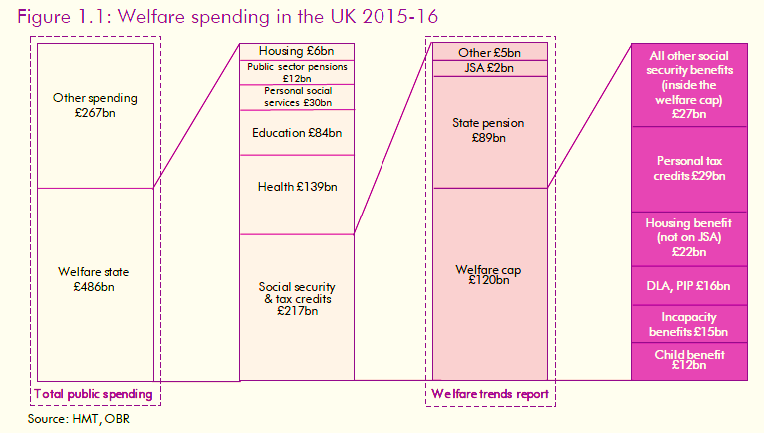
Social Security Spending
Notes:
Welfare trends report 2016 – Office of budget responsibility
Accordingly – total welfare spending is over half of all gov expenditure 486 billion.
One third of that is made up of social security (includes housing and pensions) 217 billion

Slide 5

UK Social Security System
The government department responsible for the social security system IS DWP.
Administers cash social security benefits.
Main categories of social security benefits:
Contributory benefits - e.g. retirement pension.
Means-tested benefits - Universal Credit (working age)
Categorical benefits - Child Benefit
Focus now only on working age benefits Universal Credit

Slide 6

Most radical reform of social security since its inception in 1945.
One integrated benefit – replaces 6 complex benefits
Implemented 2013-14 - Rolling programme complete 2020.
Benefit is for working age people on a low income
Entitlement – means tested based on income and savings level
Provides basic allowance - topped up by elements to recognise specific needs (housing, children, disability etc)
Everyone of working age on low income – including those who are sick or disabled to claim UC.

Slide 7

Calculating Universal Credit
Needs
Benefit top-up
Housing costs
UC paid
Elements
Earnings
Personal
allowance

Slide 8

People remain on Universal Credit (UC) as they move in and out of work
UC amount changes as pattern of work changes – 63% earnings taper
Based on monthly assessment of income
Paid directly into people’s bank accounts
HMRC – Real Time Information re income

Slide 9

Aims: ‘ambitious, complex and far–reaching’
To encourage more people into work
To make even small amounts of work pay
To smooth the transition into work with a single benefit
To tackle poverty two ways:
  by simplifying the system and making it easier for more people to claim
  by rewarding people for working more hours.

Slide 10

As Government stated in its evaluation plans (2016:11)
  ‘If there are changes in the way that working age benefits are designed, delivered, articulated and understood, this will result in better work incentives, more personal responsibility, reduced poverty and greater fairness in the welfare system’.
So design aims solve problems in previous multiple benefit system:
  Unemployment trap (where people do not become better-off if they move into work)
  Poverty trap (where it is hard to increase income by earning more, because benefit withdrawals offset increased wages
Key is greater CONDITIONALITY attached to eligibility to receive it

Slide 11

CONDITIONALITY
Driver of reform – change behaviours to find work and stay in work
Mechanism ‘Claimant Commitment’- individual action plan
Sets out required work related actions and the sanctions for non-compliance
Claimants are put in different conditionality groups depending on their status.

Slide 12
CONDITIONALITY
‘Full conditionality group’ for people not in work, have no care responsibilities and are fit to work.
  Must seek a job and take up employment of 35 hours/week at minimum living wage
The ‘no conditionality group’
  Those with child < 1 year old, or have other care responsibilities, or have serious health/disability issues stop them working.
  Are receiving UC and working 35 hours/week at minimum living wage or higher

Slide 13
CONDITIONALITY
For those in low paid work and claiming UC, they must meet the ‘Earnings Threshold’ = 35 hours/ week at minimum living wage. If they do not:
  Must work more hours – take on a second job – or increase their hourly earnings.
Some not currently fit for work (unwell /childcare) must show preparing return to work

Slide 14

SANCTIONS
The ‘Claimant Commitment’ made with the ‘work coach’.
Work coach decides if failure to comply.
Failure to comply = sanctions
Sanction lose 100% of the standard allowance part of UC.
Sanctions lose 40% if a carer/ other vulnerable categories
3 levels of sanctions:
  4 weeks - 3 months
  6 months
  3 years

Slide 15

Help With Finding Work
Job Centre Plus is local office where UC claimants meet ‘work coaches’ to agree their ‘claimant commitment’.
The Coach can refer people to the new ‘Work and Health Programme’.
Designed to provide help for sick and disabled to return to work.
Also all people can get help start their own business.

Slide 16

Help Start Own Business
Jobcentre Plus eligible and interested in setting up a business
If have a good plan, will receive a volunteer business mentor to help start business
UC claimants may apply for ‘New Enterprise Allowance’
If business starts trading get allowance for 26 weeks
May also get start-up loan 4360 ¥ to 21800 ¥
Unsecured loan – fixed 6% interest (term 1-5years)
https://www.youtube.com/watch?v=9IvS9k3xKwE&feature=youtu.be

Slide 17
Business starts
96,370 businesses set up through NEA scheme by 95,320 individuals (2011-2016).
69% of people who started a business were aged 25-49 year old.
Approx 40% women and 60% men
For 2015-16: 52% of NEA starts (31,250) progressed to set up a business
Since 2015 – New Enterprise Allowance scheme was provided by contractors appointed by DWP

Slide 18
Conclusion
UK – one function of the state is provide social security benefits
Universal credit – single benefit delivered by dwp for people of working age on low income
All claimants expected to work – conditions and sanctions
Principle: work best route out of poverty
Even if in work – expected work to a ‘threshold’
Even disabled and sick are expected prepare for work, if able
Universal credit – increasing emphasis on conditionality to drive behaviour change
Dwp also Support entrepreneurs for business start-ups

Slide 19
NEA -

